Slide 1
Data Structures
Lecture 2
Multidimensional Array
Prantik Paul [PNP]
Lecturer
Department of Computer Science and Engineering
BRAC University

Slide 2
MultiDimensional Array (Initialize)
1D Array
array1D = np.zeros(5)
2D Array
array2D = np.zeros((5,2))
3D Array
array3D = np.zeros(?)

Slide 3
MultiDimensional Array (Initialize)
1D Array
array1D = np.zeros(5, dtype = int)
2D Array
array2D = np.zeros((5,2), dtype = int)
3D Array
array3D = np.zeros(?)

Slide 4
MultiDimensional Array (Initialize)
1D Array
array1D = np.array([1,2])
2D Array
array2D = np.array([[1,2], [3,4]])
3D Array
array3D = np.array(?)

Slide 5
MultiDimensional Array (Initialize)
1D Array
array1D = np.array([1,2])
2D Array
array2D = np.array([[1,2], [3,4]])
3D Array
array3D = np.array([[[1,2],[3,4]],[[5,6],[7,8]]])

Slide 6
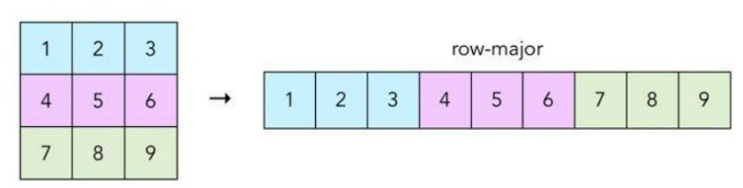
MultiDimensional Array (In Memory)
Row Major Ordering

Slide 7
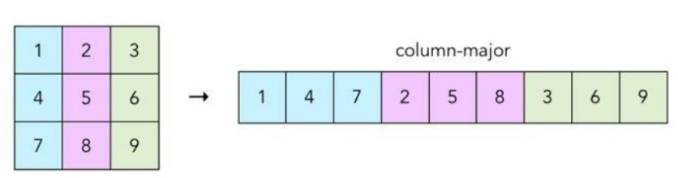
MultiDimensional Array (In Memory)
Column Major Ordering

Slide 8
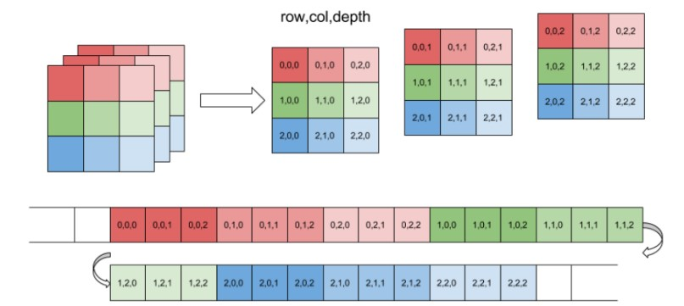
MultiDimensional Array (In Memory)
3D Array

Slide 9
MultiDimensional Array (Index Finding)
3D Array
arr[M][N][O]
arr[1][2][2]
1*N*O + 2*O + 2

Slide 10
MultiDimensional Array (Index Finding)
4D Array
arr[M][N][O][P]

Slide 11
MultiDimensional Array (Reverse Indexing)
3D Array
arr[M][N][O]
M = 4
N= 4
O = 8
Location 111

Slide 12
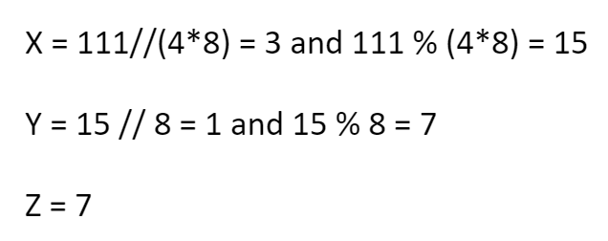
MultiDimensional Array (Reverse Indexing)
3D Array
111 = M * (4*8) + N * 8 + O

Slide 13
MultiDimensional Array (Reverse Indexing)
3D Array
96, 107, 60

Slide 14
MultiDimensional Array (Iteration - array)
2D Array

Slide 15
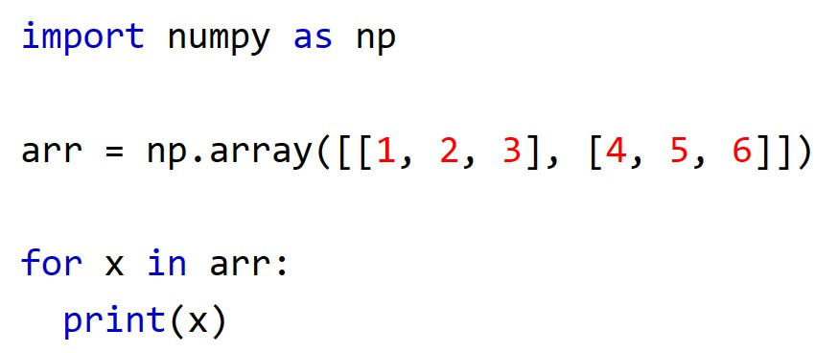
MultiDimensional Array (Iteration - array)

Slide 16
MultiDimensional Array (Iteration - element)
2D Array

Slide 17
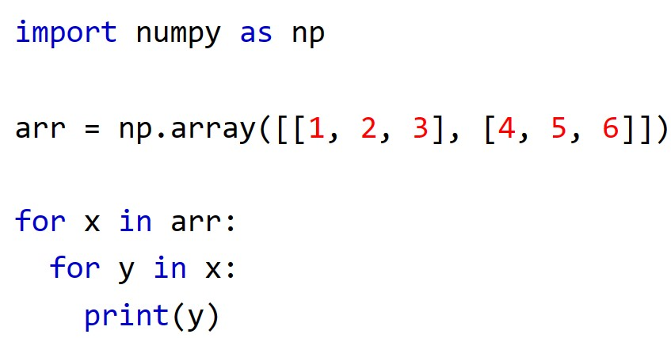
MultiDimensional Array (Iteration - element)

Slide 18
MultiDimensional Array (Iteration - element)
3D Array

Slide 19
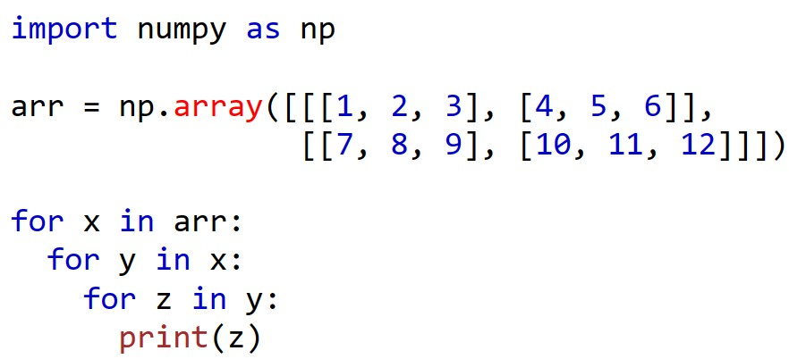
MultiDimensional Array (Iteration - element)

Slide 20
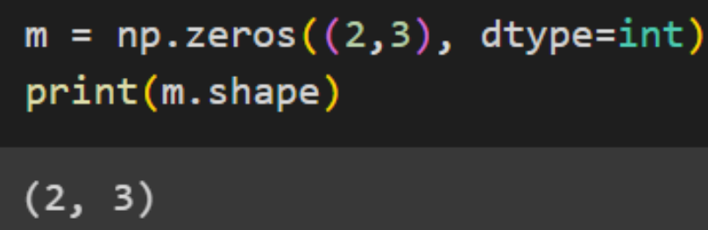
2D Array (Shape)

Slide 21
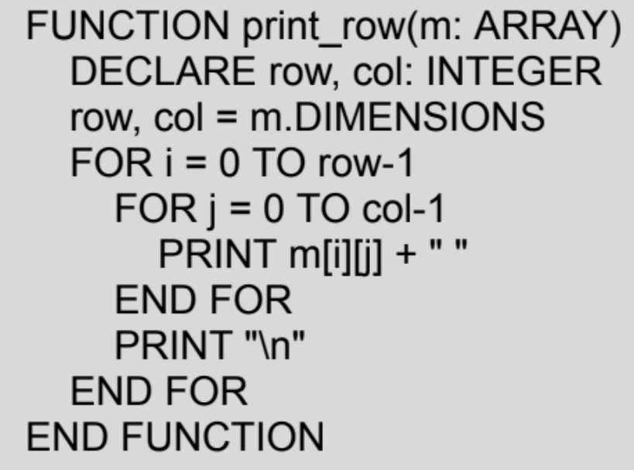
2D Array (Iteration - Row Wise)

Slide 22
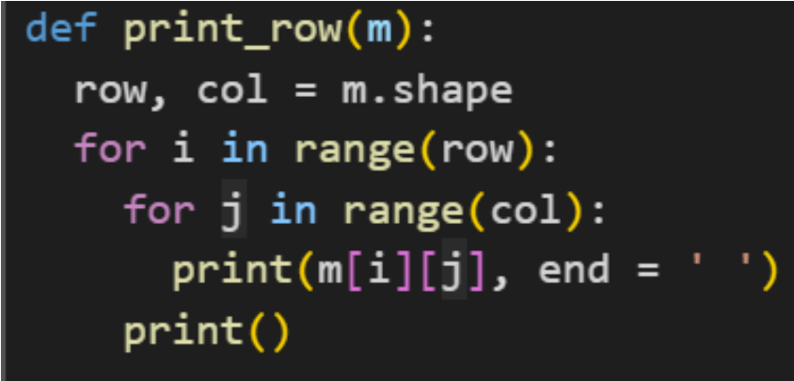
2D Array (Iteration - Row Wise)

Slide 23
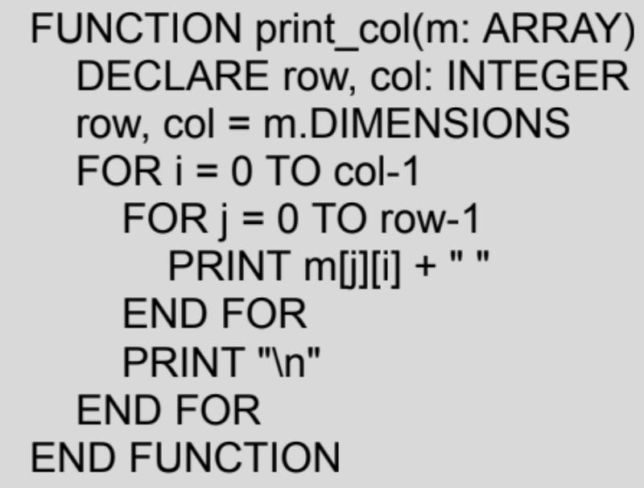
2D Array (Iteration - Column Wise)

Slide 24
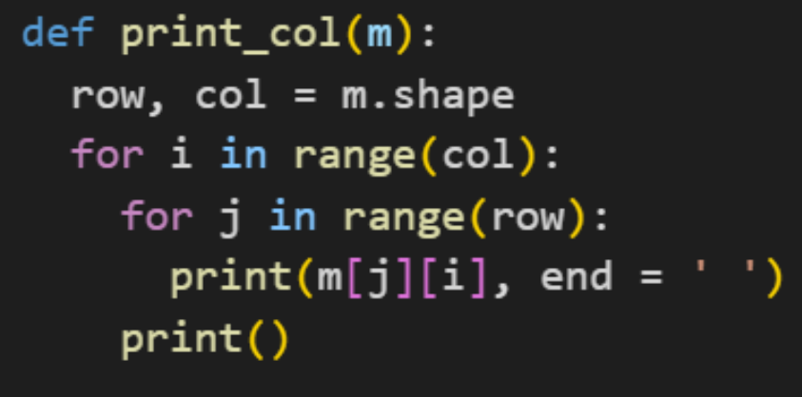
2D Array (Iteration - Column Wise)

Slide 25
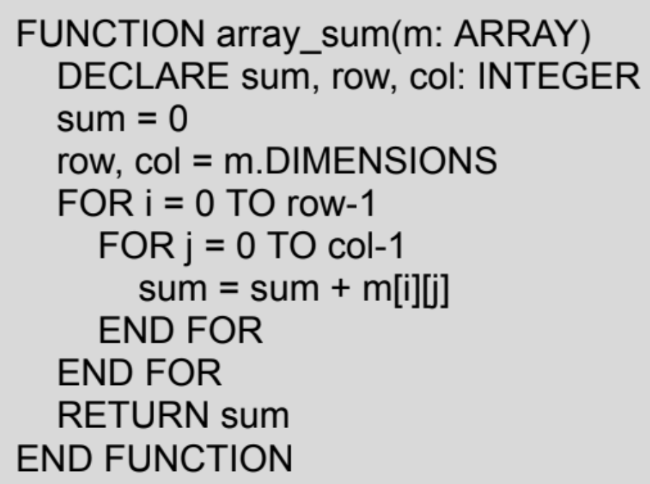
2D Array (Summation)

Slide 26
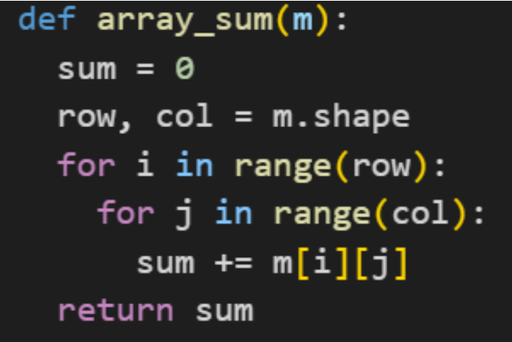
2D Array (Summation)

Slide 27
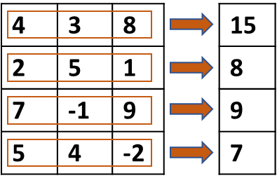
2D Array (Summation along Rows)

Slide 28
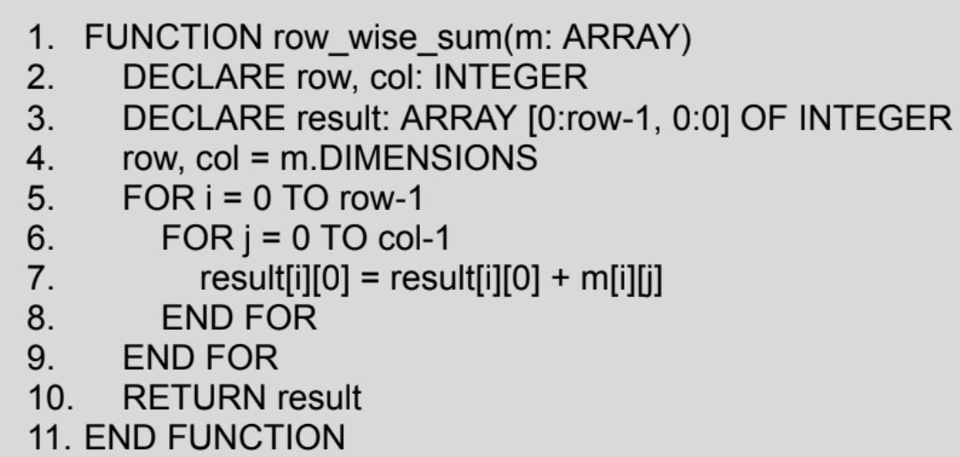
2D Array (Summation along Rows)

Slide 29
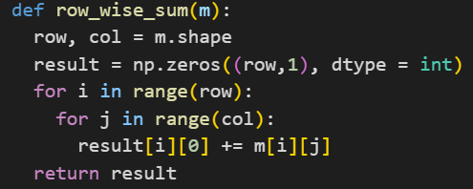
2D Array (Summation along Rows)

Slide 30
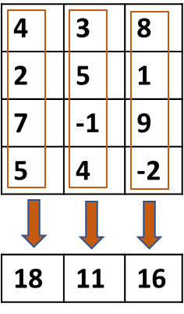
2D Array (Summation along Columns)

Slide 31
2D Array
Find The Largest Number in a 2D Array

Slide 32
2D Array
Find The Largest Number in Each Row in a 2D Array. Then Find The Smallest Among Them

Slide 33
2D Array
Find The Smallest Number in Each Column in a 2D Array. Then Find The Largest Among Them

Slide 34
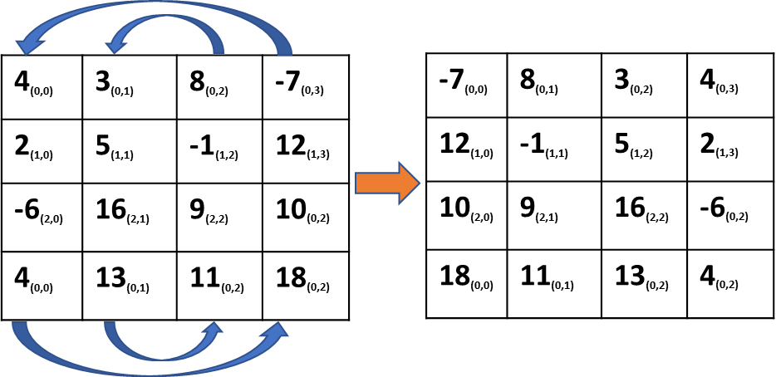
2D Array (Swap Columns of m*n matrix)

Slide 35
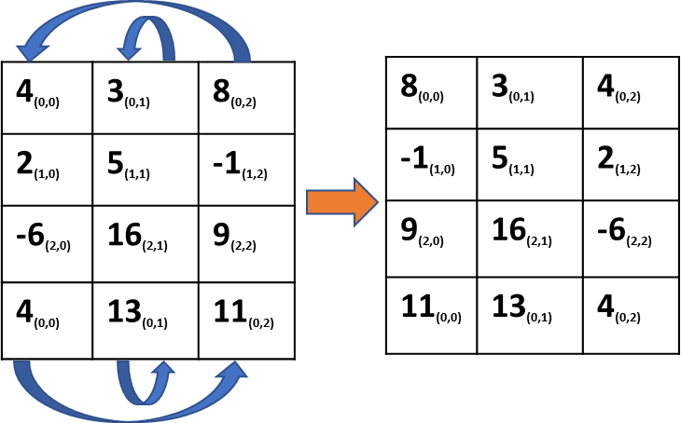
2D Array (Swap Columns of m*n matrix)

Slide 36
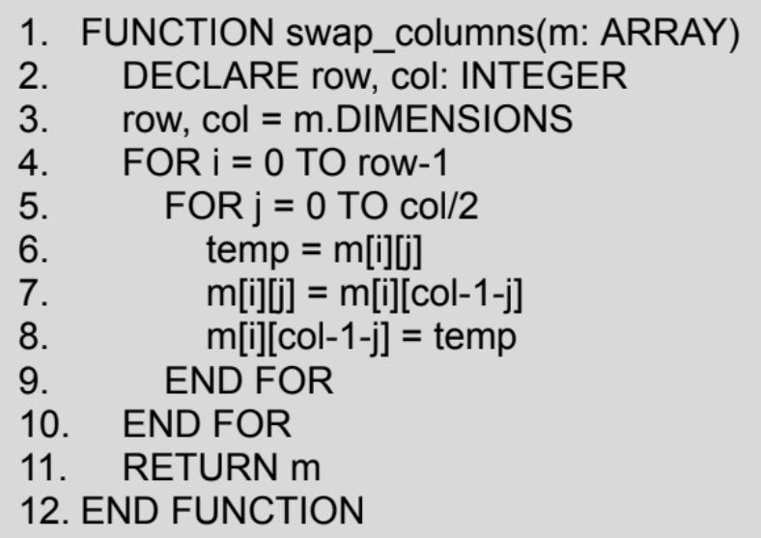
2D Array (Swap Columns of m*n matrix)

Slide 37
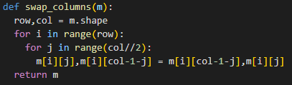
2D Array (Swap Columns of m*n matrix)

Slide 38
2D Array
Swap Rows of m*n matrix

Slide 39
2D Array
Row Wise Shift
Row Wise Rotation
Column Wise Shift
Column Wise Rotation

Slide 40
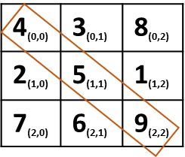
2D Array (Add elements of primary diagonal)

Slide 41
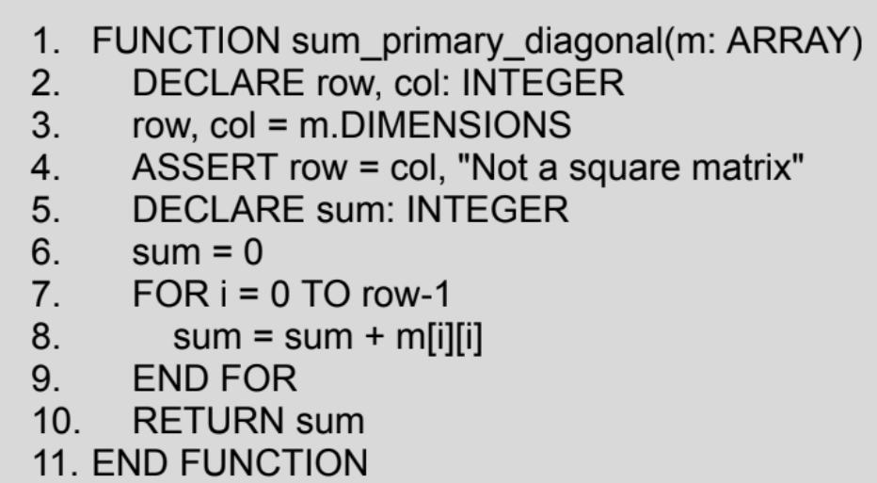
2D Array (Add elements of primary diagonal)

Slide 42
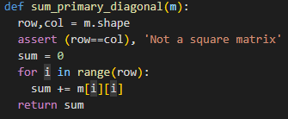
2D Array (Add elements of primary diagonal)

Slide 43
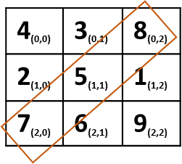
2D Array (Add elements of secondary diagonal)

Slide 44
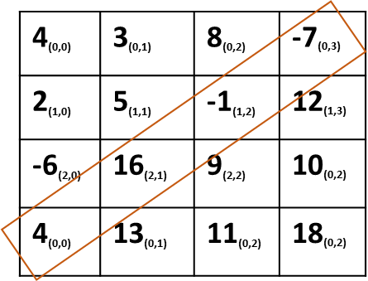
2D Array (Add elements of secondary diagonal)

Slide 45
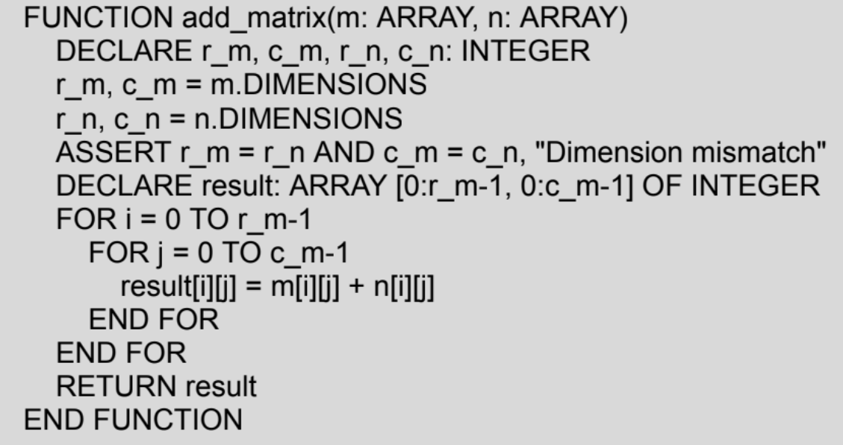
2D Array (Add 2 Matrices)

Slide 46
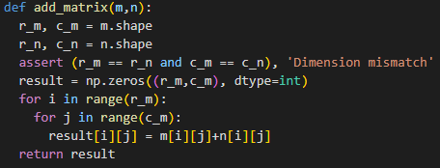
2D Array (Add 2 Matrices)

Slide 47
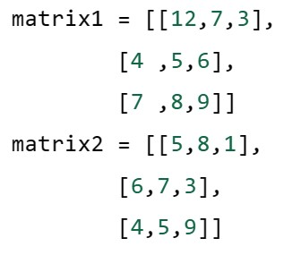
2D Array (Multiply Matrices)

Slide 48
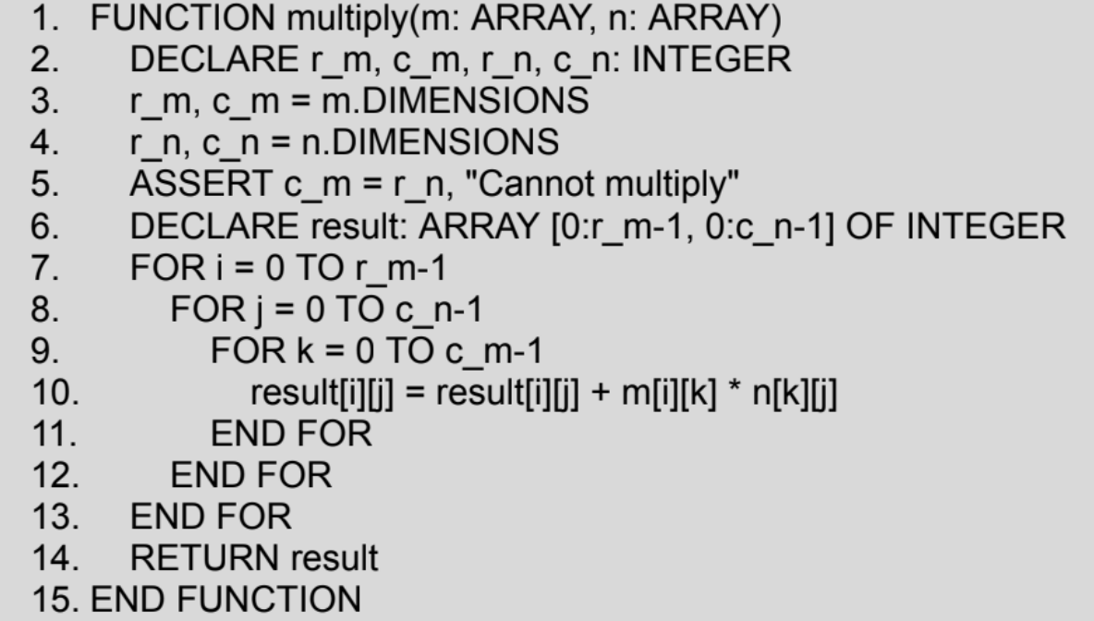
2D Array (Multiply Matrices)

Slide 49
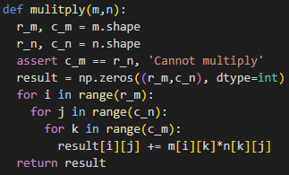
2D Array (Multiply Matrices)

Slide 50
MultiDimensional Array (Multiply Matrices)
Multiply Matrices (Geeks for Geeks)

